Slide 1
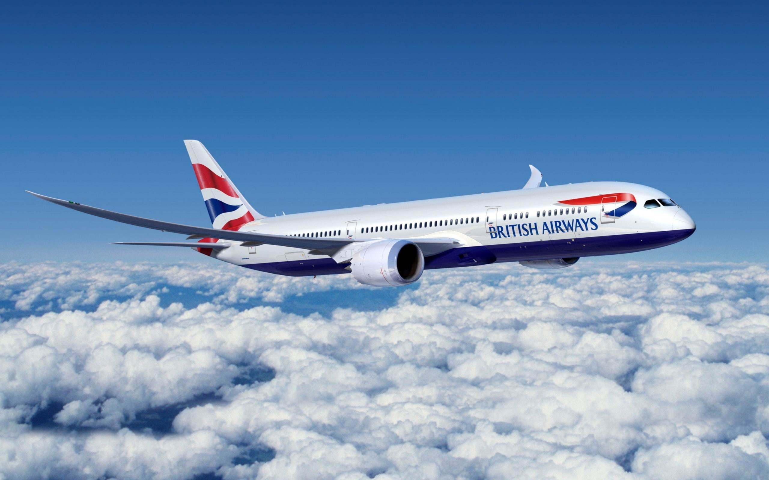

TITLE
Web scraping of reviews to gain insights
By : Dinesh Rawat
Date : 6/24/2023
Forage British Airways Virtual Internship program

Slide 2
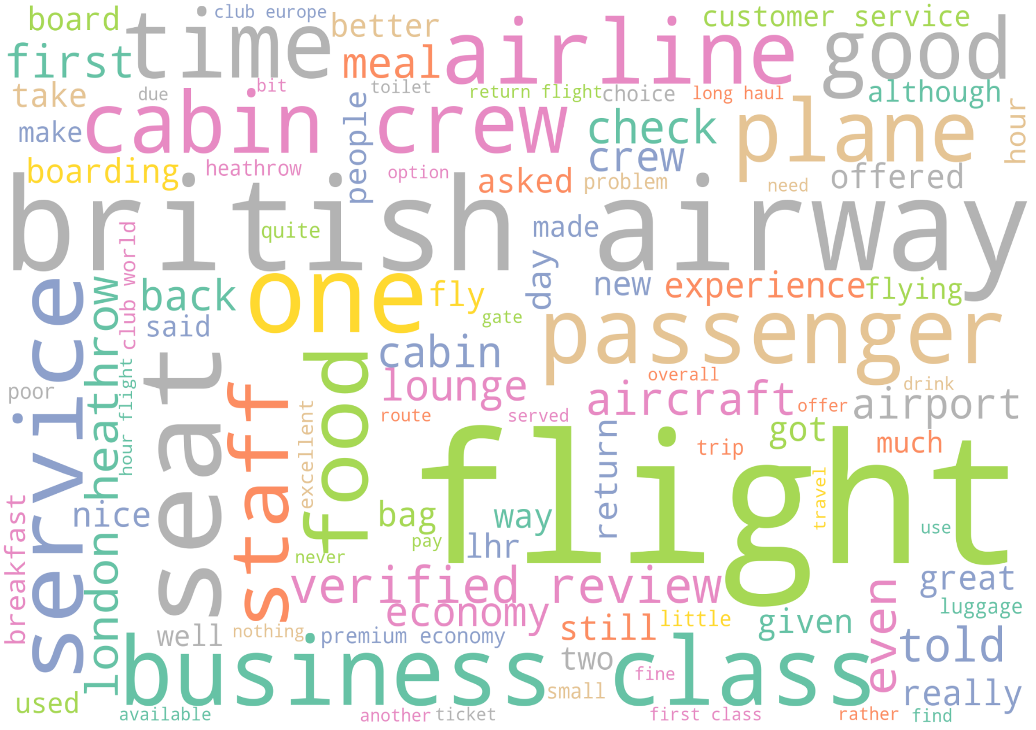
Insights on British Airways Review
Total No. Of Reviews Analyzed: 3400
Positive Reviews : 2406
Negative Reviews : 981
Neutral Reviews : 13
Most Positive Review.
'very impressed with premium economy on ba sydney to heathrow and return. nice also to have an unsolicited upgrade to business on return singapore to sydney.'
Most Negative Review
'mykonos to london flight delayed and waiting to depart. they are not on time, be prepared to miss your connections, take off 2 hours late,. the staff is some of the worst i have had on airlines. you may be stuck on the runway and they won’t offer you any water. the worst business class experience i have had.'

Slide 3
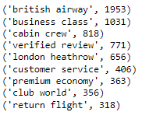
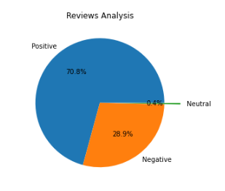
Insights on British Airways Review
Top 10 pairs of word present in the reviews
Sentiment
Longest review is of 655 words Shortest review is of 15 words

